Slide 1


Slide 2
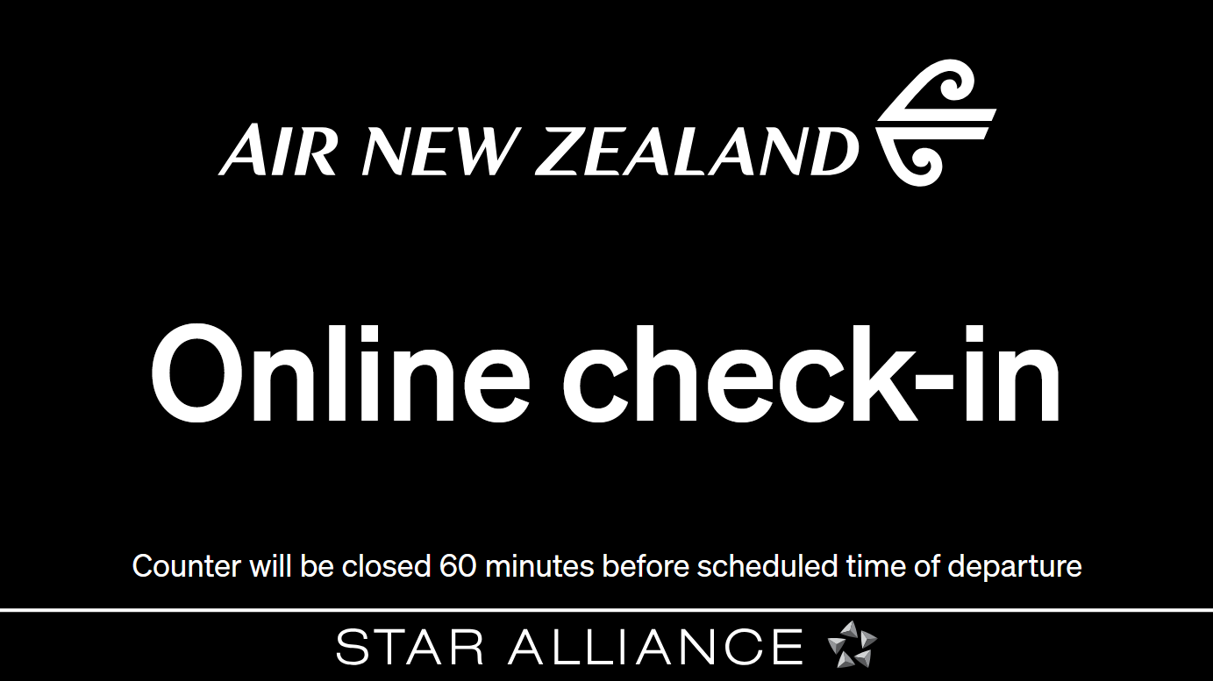

Slide 3
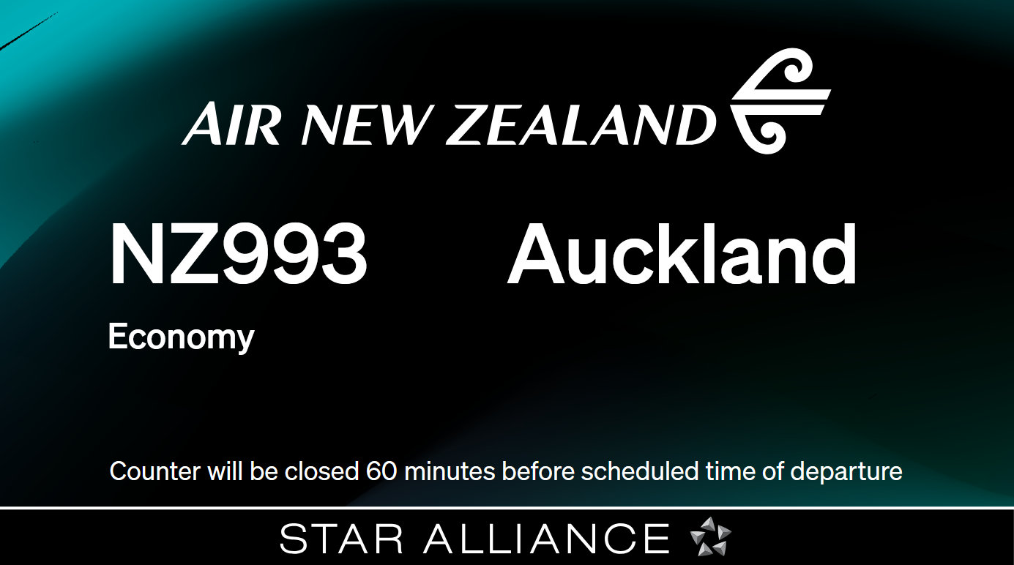

Slide 4
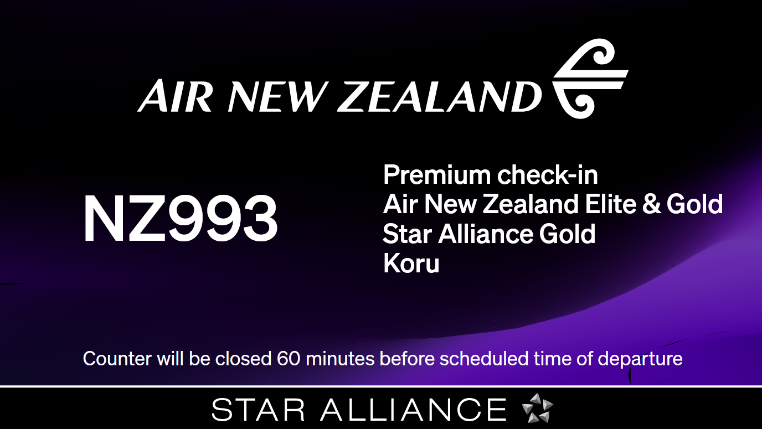

Slide 5
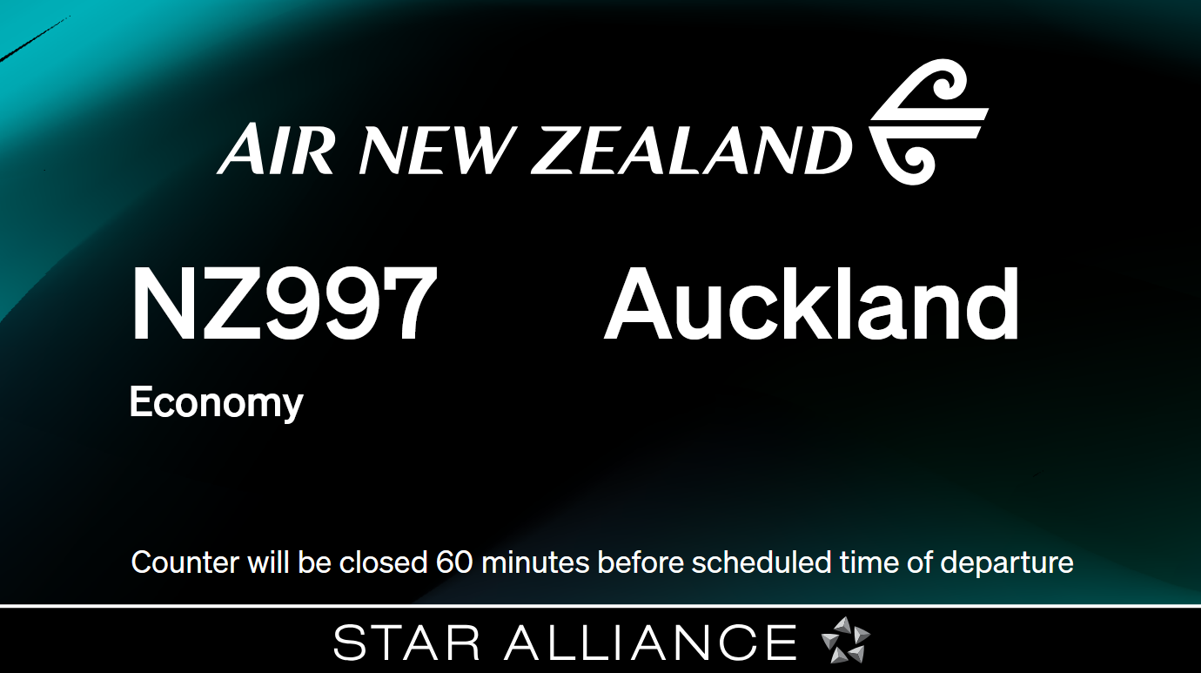

Slide 6
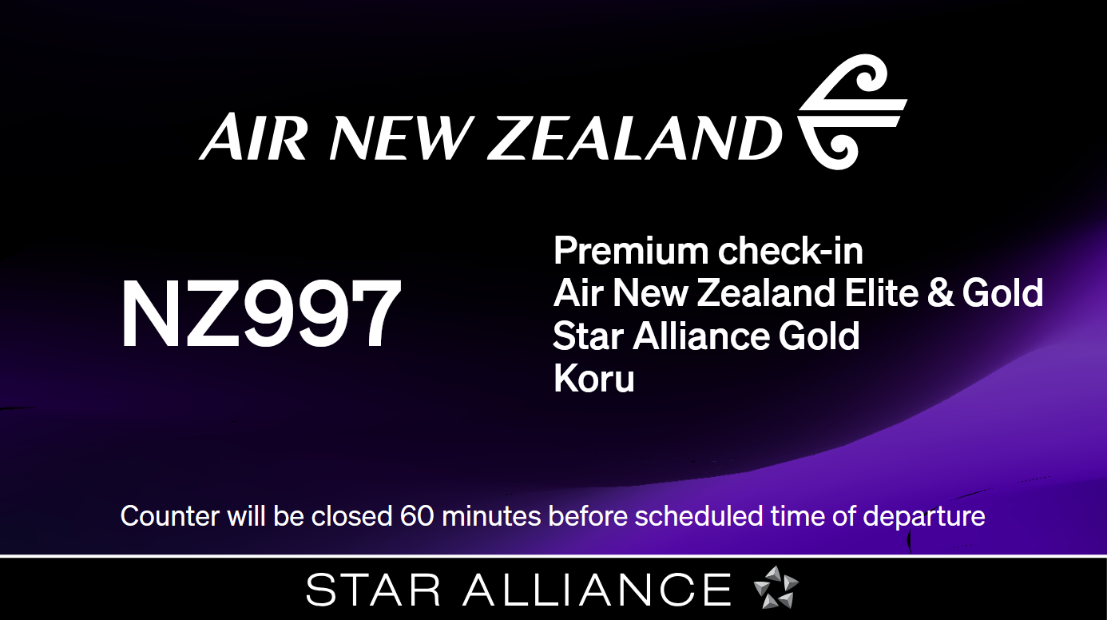

Slide 7
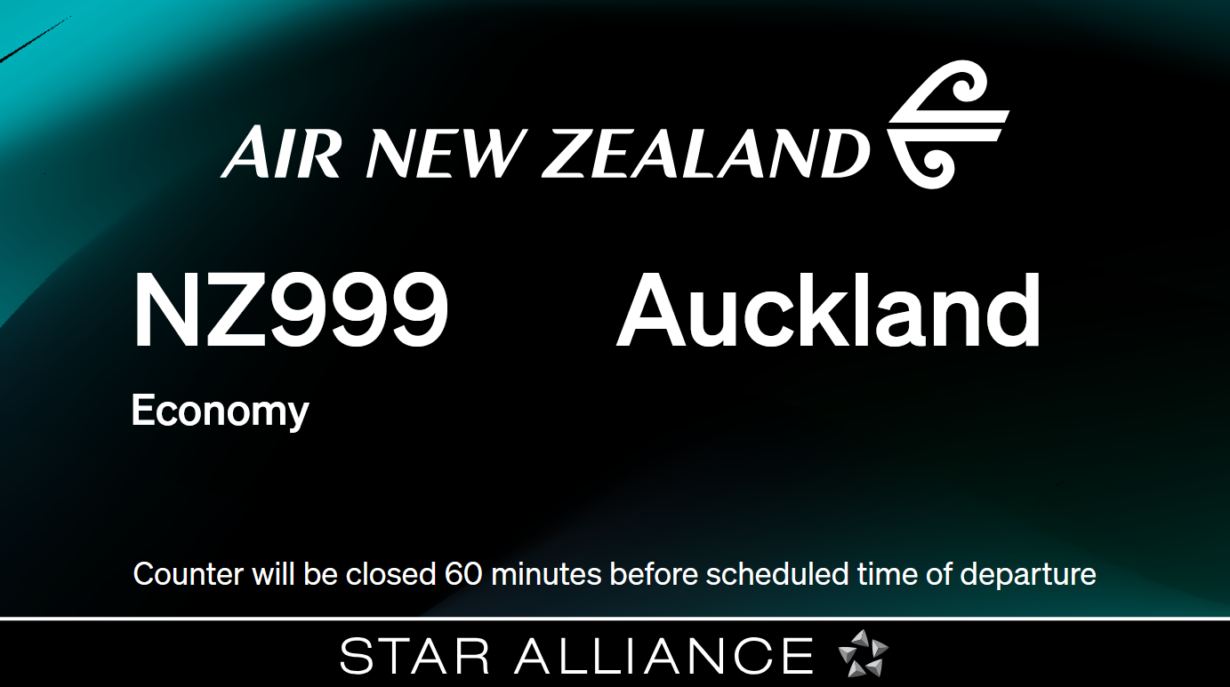

Slide 8
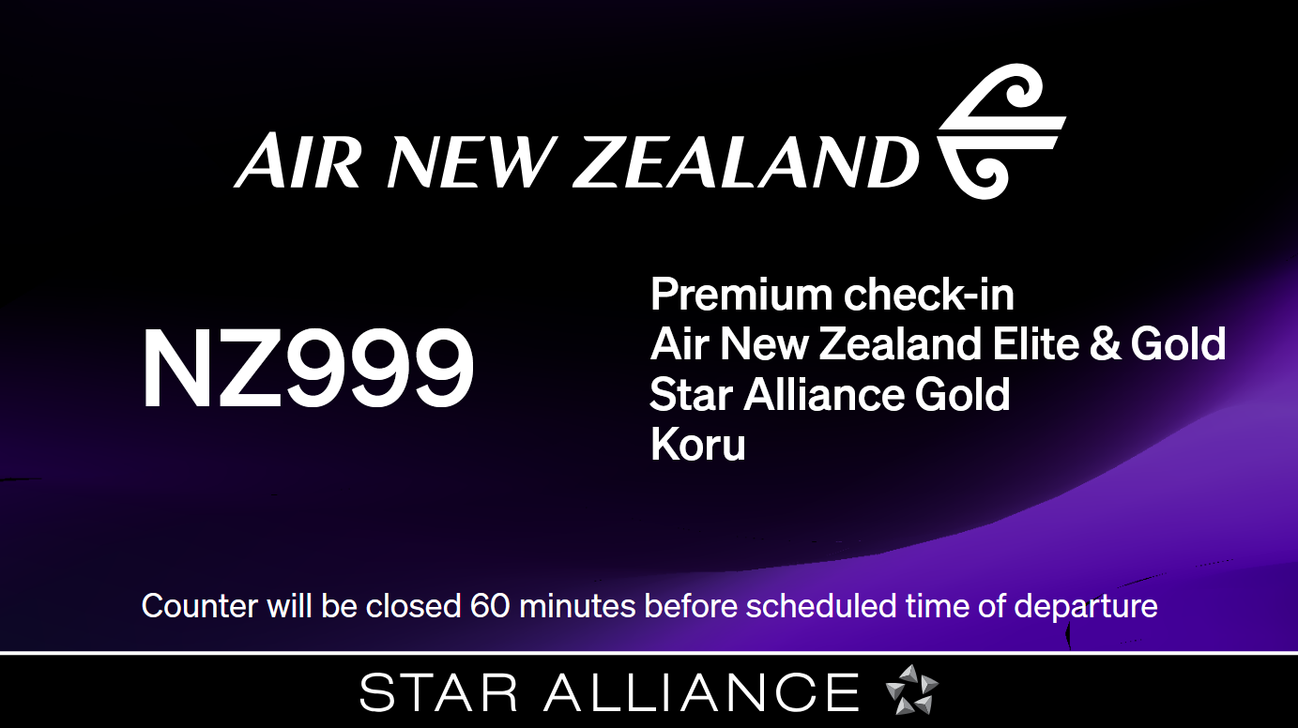

Slide 9
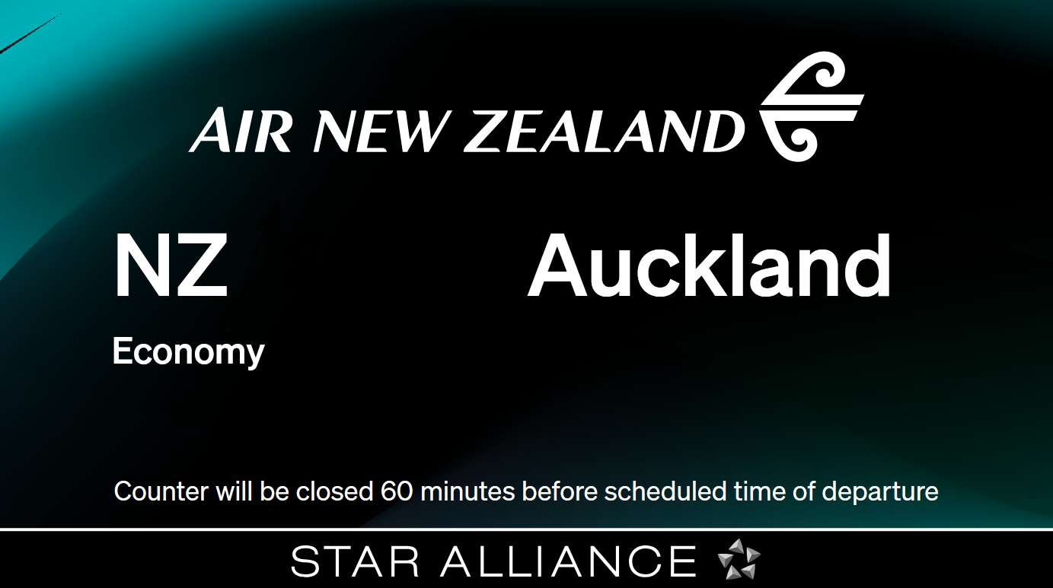
1307

Slide 10
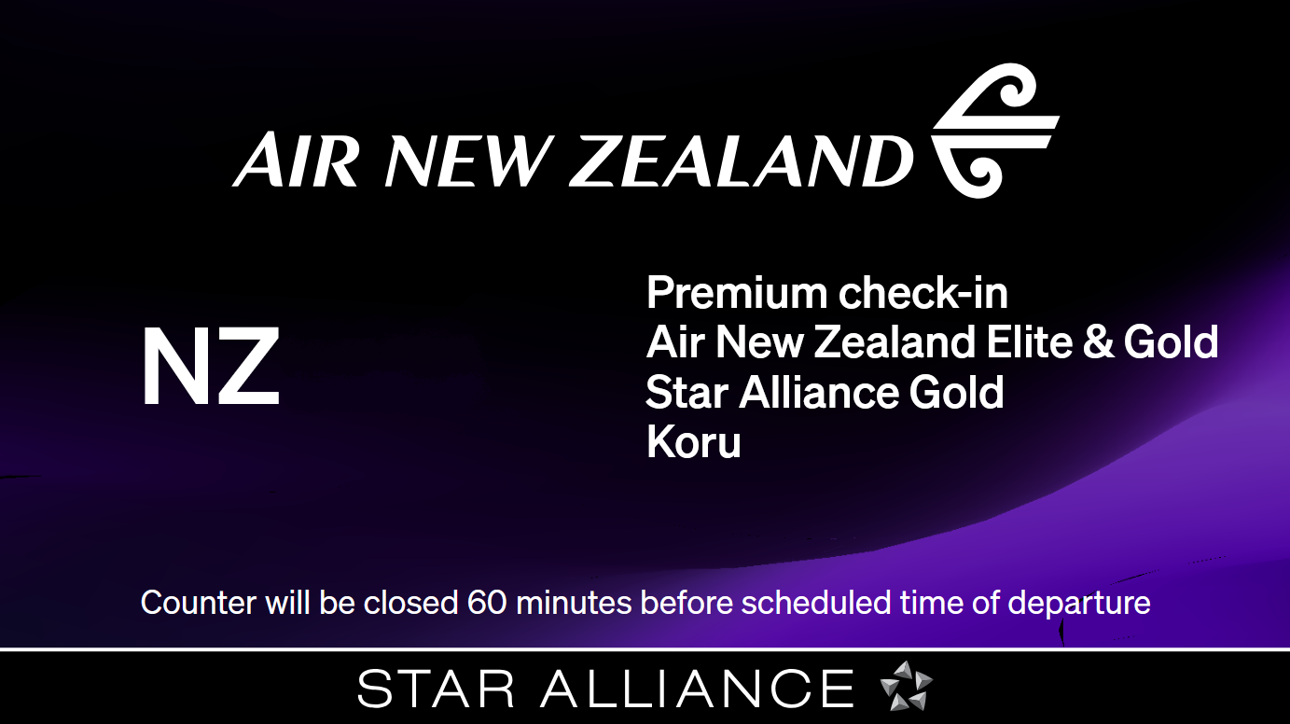
1307

Slide 11
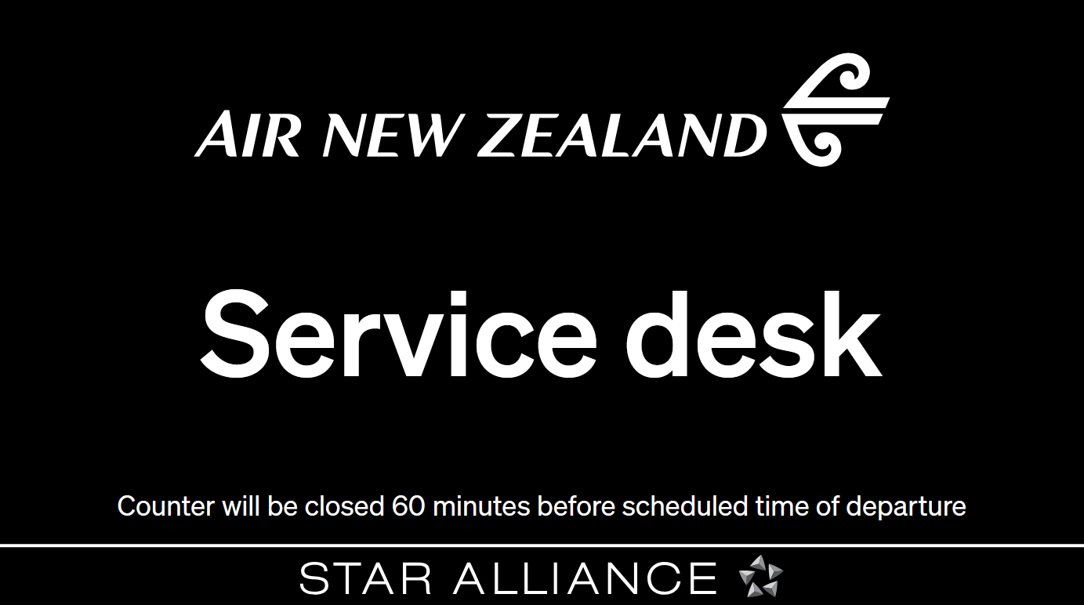

Slide 12
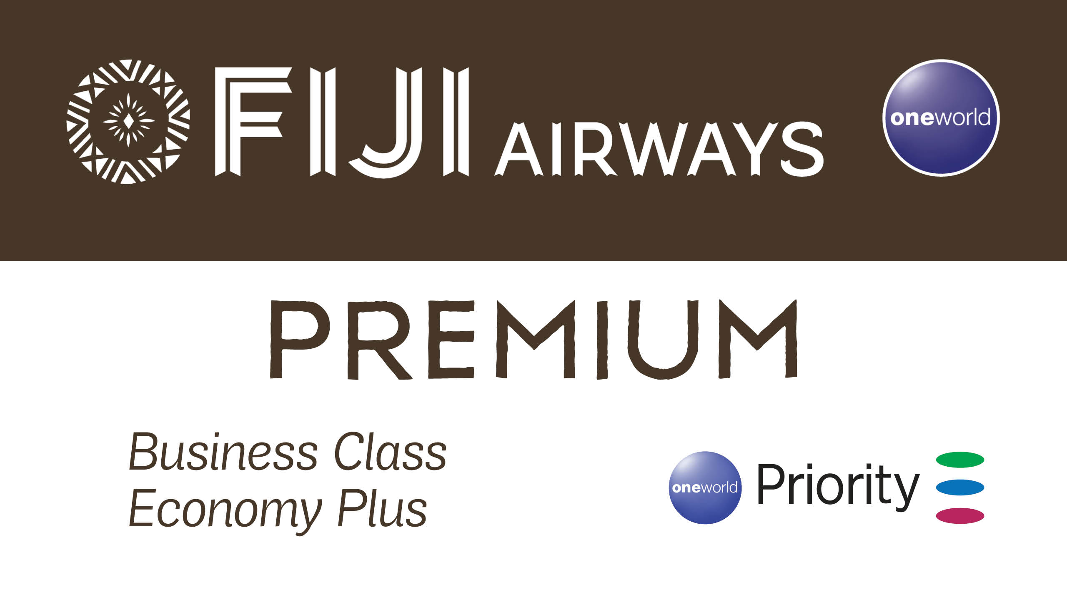

Slide 13
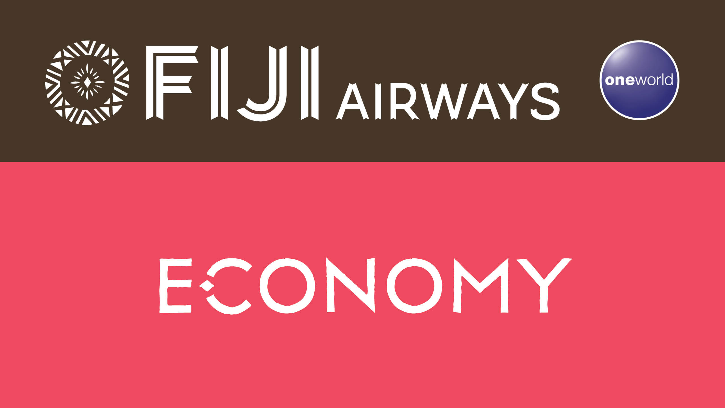

Slide 14
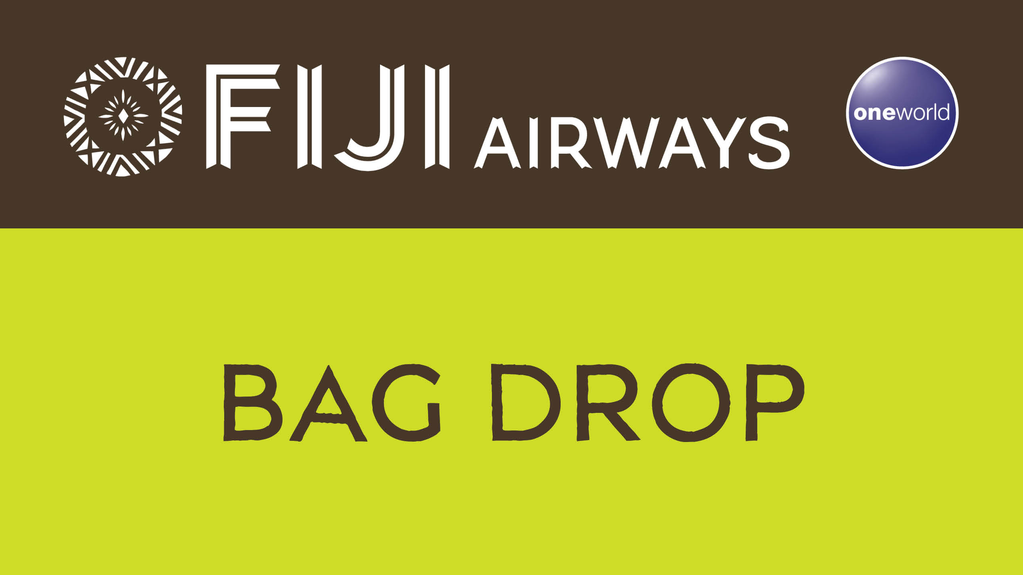

Slide 15
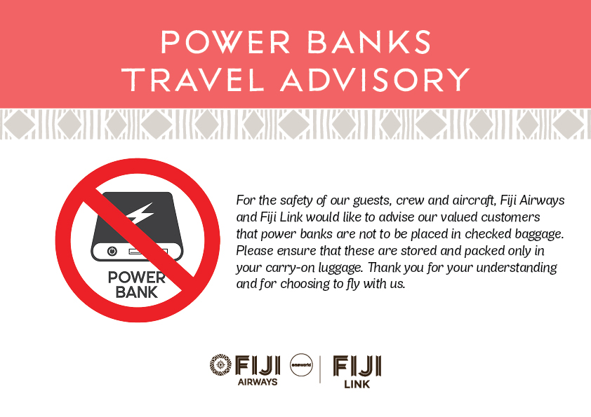

Slide 16
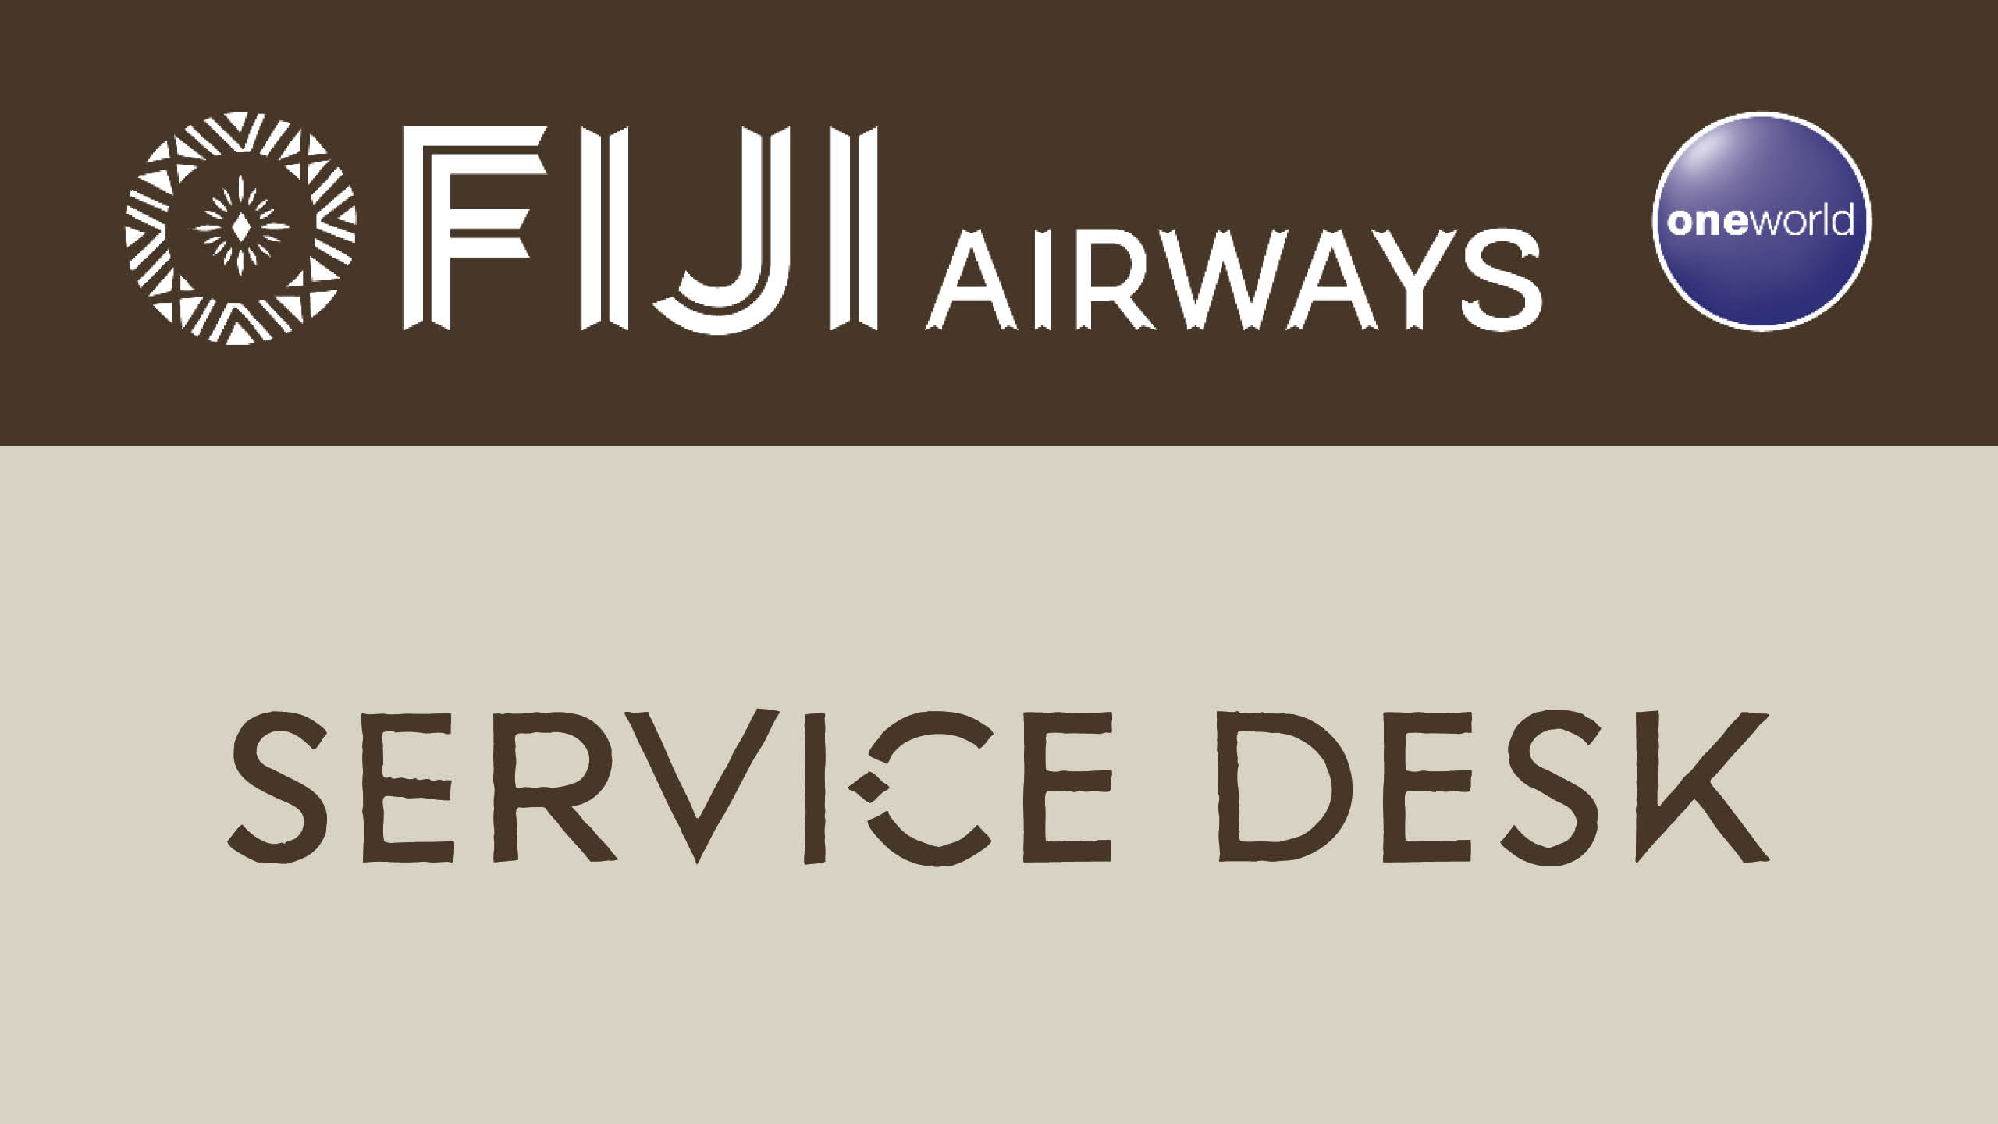

Slide 17
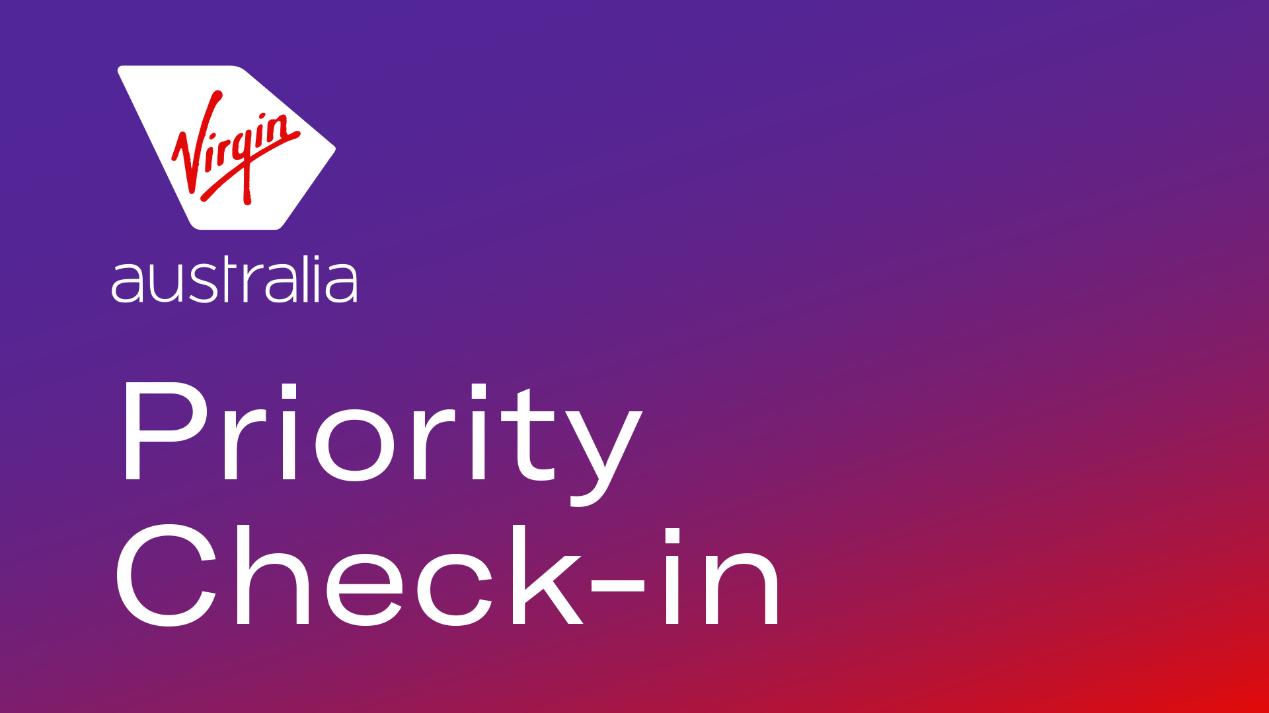

Slide 18


Slide 19
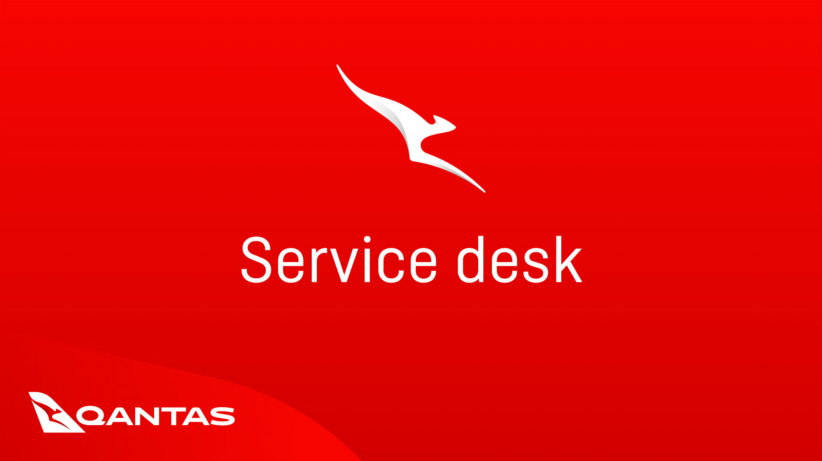
QF198
ONLINE CHECK-IN

Slide 20

QF198

Slide 21

QF198

Slide 22
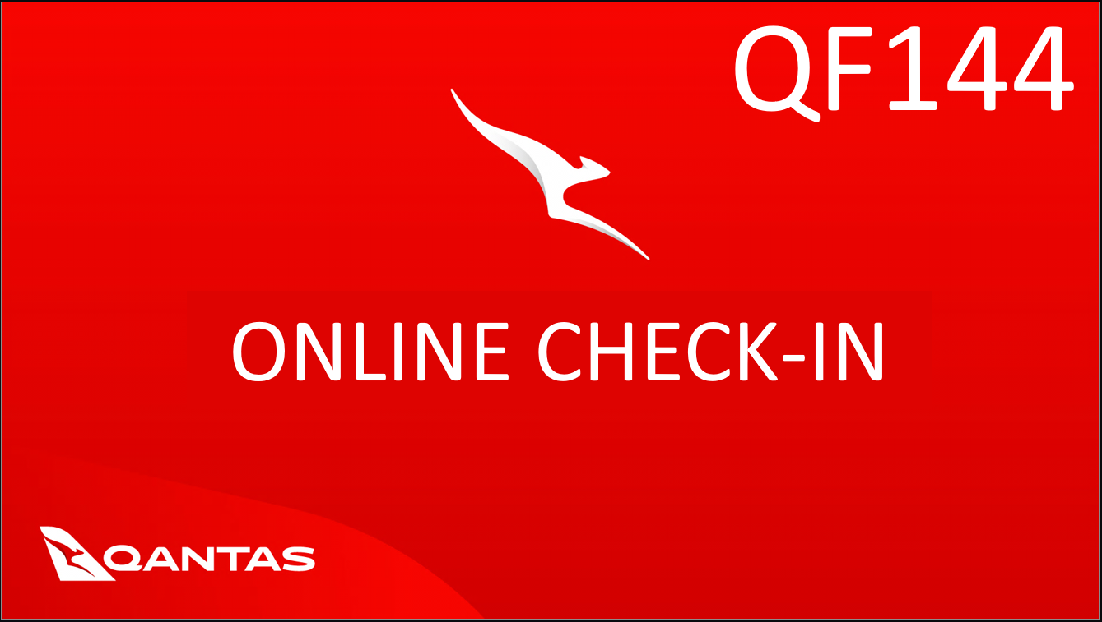

Slide 23
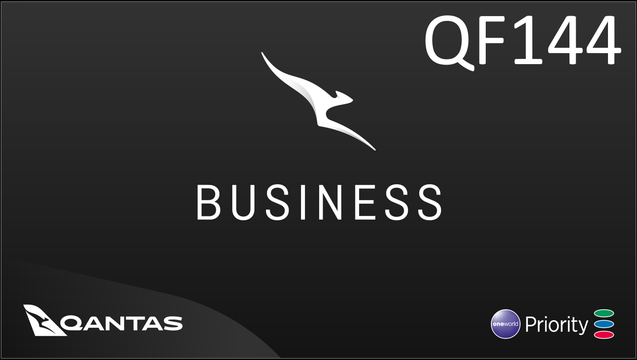

Slide 24
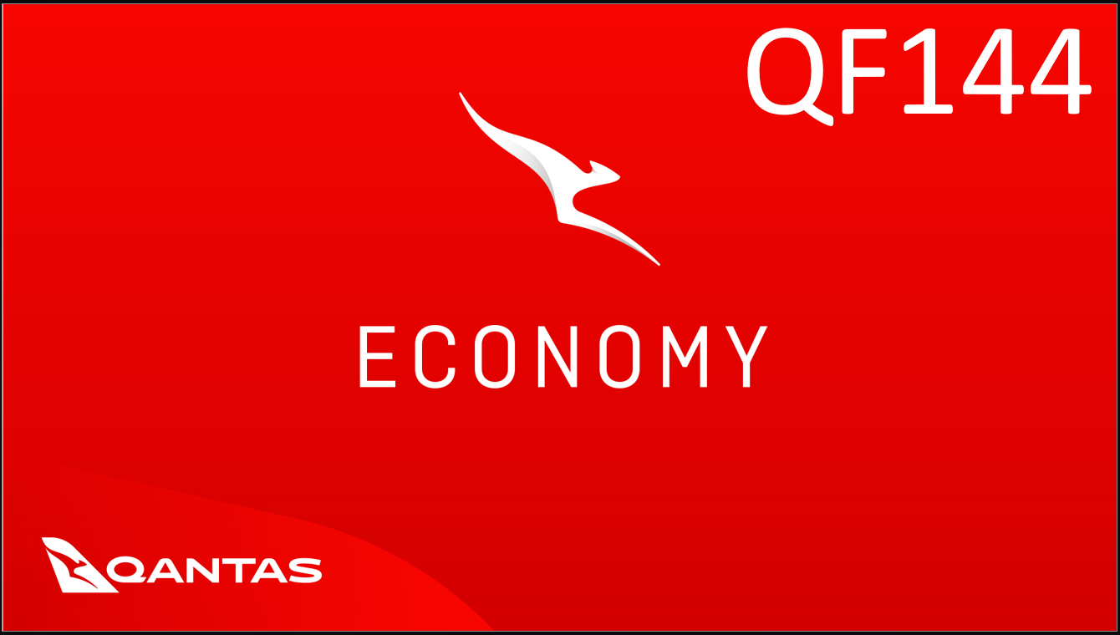

Slide 25

The Australian government has mandated additional checks for those flying to and from Australia.
No liquids, aerosols or gels over 100ml (3.4oz)
Liquids and beverages purchased in the terminals restricted area, are NOT permitted
Duty Free purchases of liquids, aerosols and gels (including water) will be permitted if delivered to the gate in a sealed bag with proof purchase.

Slide 26
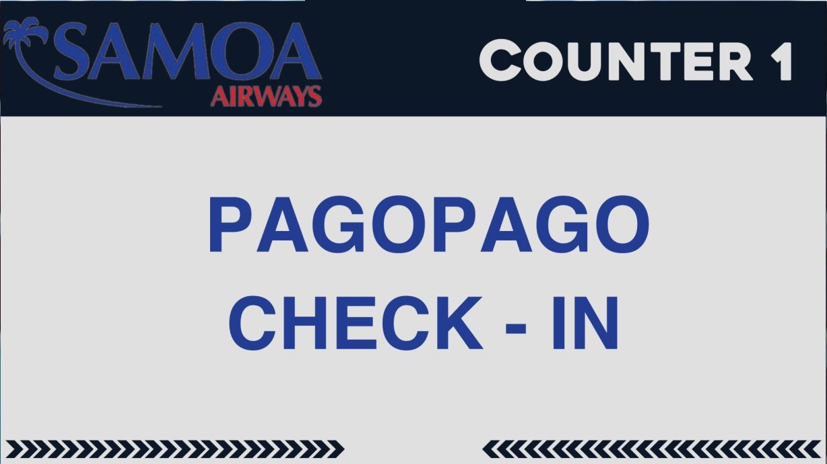

Slide 27
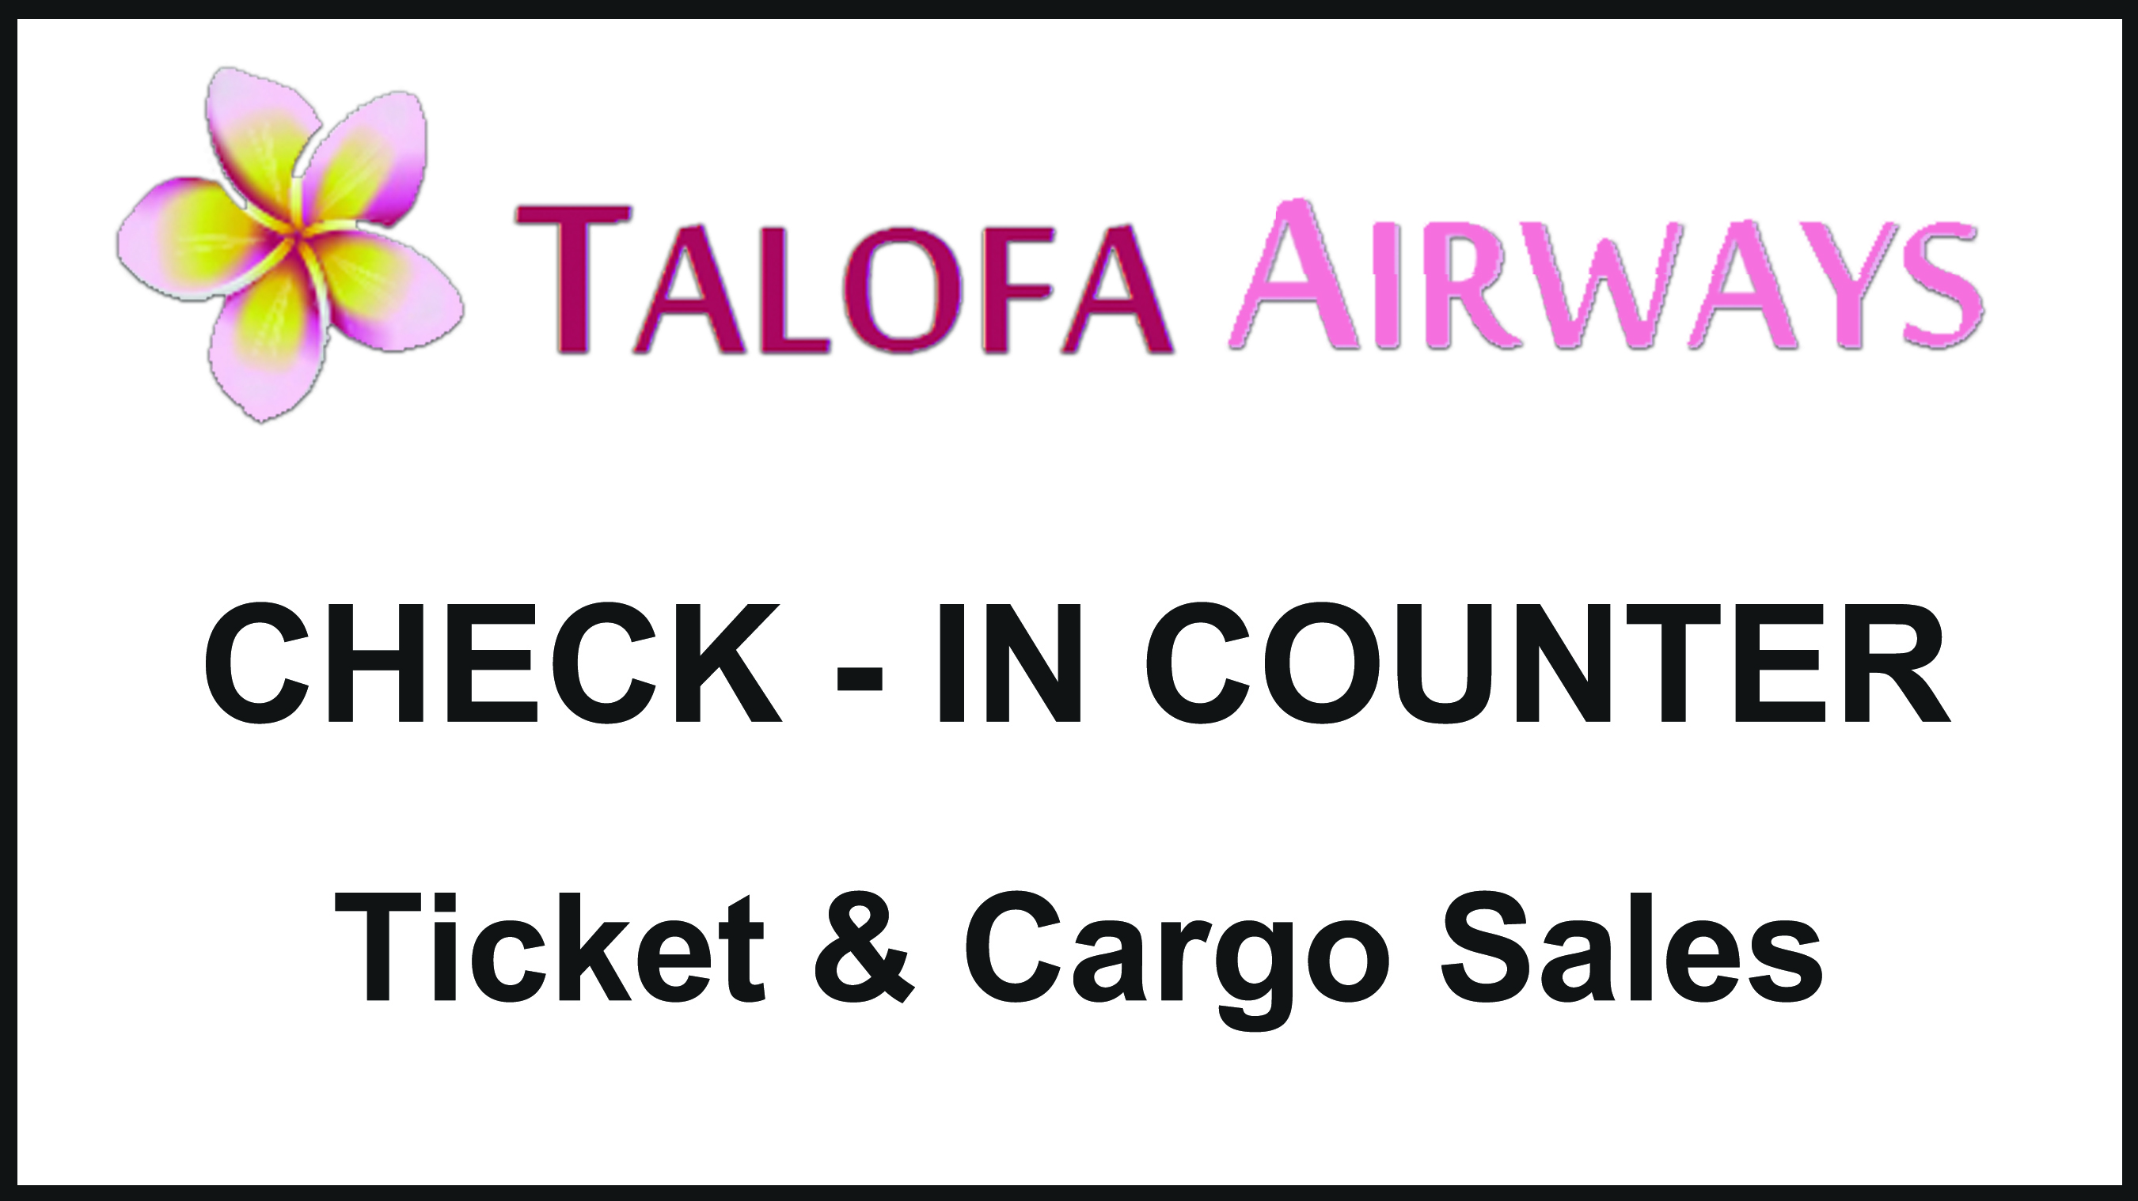

Slide 28
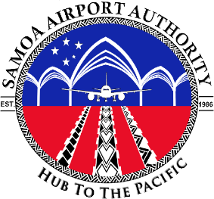
SPECIAL ANNOUCEMENT
Departure Tax for Travelling Passengers bound for American Samoa
This is to inform all our Departing Passengers bound for American
Samoa flights are advised to pay your departure taxes at the
Aviation Security Screening & Checking point before boarding.
      All passengers 12 years and over - $65
      From 2 years and below 12 years - $15
      Infants below 2 years are free.
Thank you
SAA Management

Slide 29

FA’ASILASILAGA TAUA
LAFOGA TAGATA MALAGA MO FAIGA MALAGA AMERIKA SAMOA
I le ava tele ma le fa’aaloalo e fa’asilasila atu ai mo i latou e faimalaga mo Amerika Samoa e fa’apea.
E fa’amanatu atu a outou lafoga e totogi i le vaega o loo fa’atino ai le siaki ma su’esu’ega a le Aviation Security ae le’i tu’uva’a atu mo le faigamalaga.
        12 tausaga ma luga atu e $65.
        Mai le 2 – 11 tausaga e $15
        Lalo mai o le 2 tausaga e leai se lafoga.
Fa’afetai
Pulega o Malaeva’alele

